Slide 1
MAT 411 : Deep Learning Project
Title: Deep Learning approach for detecting credit card fraud transactions.
Shinjon Ghosh
Graduate Student
Department of Mathematics

Slide 2
Background Study
Nowadays credit cards payments is most popular modern financial transactions.
It provides a convenient way to make purchases all over the world and financially flexible for users.
In the meantime, the North American institutions losses $246 million and globally almost $35 billion by credit cards fraud in 2023. Currently, a lot of financial security-based institutions try to find out how to protect fraud credit card transactions.

Slide 3
Dataset
Collect the dataset from Kaggle.
It consists of two days’ worth of real bank transactions made by European cardholders in 2013.
The total number of transactions is 284,807. Only 492 (0.2 percent) of them are fraudulent.
Each credit card transaction is represented by 30 features.

Slide 4
Goal and Main Challenges
Use a training set of legal transactions and teach a deep learning algorithm to replicate the feature vector of each transections.
If the distance between the original and reproduced transactions falls below a specified threshold, the transaction is authentic.
However, if the distance exceeds the threshold, the transaction is flagged as a potential fraud candidate.
We have a highly imbalanced dataset. Normal transactions(284315) overwhelm the fraudulent(492) ones by a large margin.

Slide 5
Autoencoder
An autoencoder is a feed-forward multilayer neural network that reproduces the input data on the output layer.
So, the number of output units must be the same as the number of input units.
The autoencoder is usually trained using the backpropagation algorithm against a loss function, like the mean squared error (MSE).

Slide 6
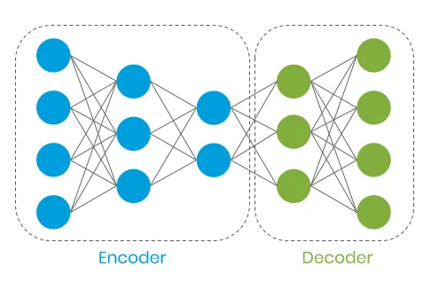
Autoencoder

Slide 7
Building the Model
Built an autoencoder with three hidden layers, with the number of units 30–14–7–14–30 and tanh
Use reLu as activation functions.
The autoencoder was trained with Adam — an optimized version of backpropagation — on just legal transactions.
Draw 150 epochs, against the MSE as a loss function.

Slide 8










Data Processing

Slide 9
Data Processing:
from sklearn.preprocessing import StandardScaler
data = df.drop(['Time'], axis=1)
Data['Amount'] = StandardScaler().fit_transform(data['Amount'].values.reshape(-1, 1))
X_train, X_test = train_test_split(data, test_size=0.1, random_state=RANDOM_SEED)
X_train = X_train[X_train.Class == 0]
X_train = X_train.drop(['Class'], axis=1)
y_test = X_test['Class']
X_test = X_test.drop(['Class'], axis=1)
X_train = X_train.values
X_test = X_test.values

Slide 10
Autoencoder Model:
input_dim = X_train.shape[1]
encoding_dim = 30
input_layer = Input(shape=(input_dim, ))
encoder = Dense(encoding_dim, activation="tanh",
activity_regularizer=regularizers.l1(10e-10))(input_layer)
encoder = Dense(int(encoding_dim - 16), activation=“tanh")(encoder)
encoder = Dense(int(encoding_dim - 23), activation="relu")(encoder)
decoder = Dense(int(encoding_dim - 16), activation='tanh')(encoder)
decoder = Dense(input_dim, activation='relu')(decoder)
autoencoder = Model(inputs=input_layer, outputs=decoder)

Slide 11
nb_epoch = 150
batch_size = 32
autoencoder.compile(optimizer='adam',
loss='mean_squared_error',
metrics=['accuracy'])
checkpointer = ModelCheckpoint(filepath="model.h5",
verbose=0,
save_best_only=True)
tensorboard = TensorBoard(log_dir='./logs',
histogram_freq=0,
write_graph=True,
write_images=True)
history = autoencoder.fit(X_train, X_train,
epochs=nb_epoch,
batch_size=batch_size,
shuffle=True,
validation_data=(X_test, X_test),
verbose=1,
callbacks=[checkpointer, tensorboard]).history

Slide 12
Precision vs Recall
Precision measures the relevancy of obtained results.
Recall measures how many relevant results are returned.
High recall but low precision means many results, most of which has low or no relevancy.
High precision high but low recall means few returned results with very high relevancy.
A high area under the curve represents both high recall and high precision, where high precision relates to a low false positive rate, and high recall relates to a low false negative rate.

Slide 13
Precision and Recall plot:
predictions = autoencoder.predict(X_test)
mse = np.mean(np.power(X_test - predictions, 2), axis=1)
error_df = pd.DataFrame({'reconstruction_error': mse,
'true_class': y_test})
precision, recall, th = precision_recall_curve(error_df.true_class, error_df.reconstruction_error)
plt.plot(recall, precision, 'b', label='Precision-Recall curve')
plt.title('Recall vs Precision')
plt.xlabel('Recall')
plt.ylabel('Precision')
plt.show()

Slide 14
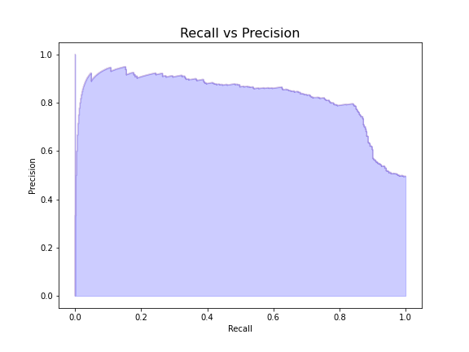
Precision vs Recall

Slide 15
Confusion Matrix:
y_pred = [1 if e > threshold else 0 for e in error_df.reconstruction_error.values]
conf_matrix = confusion_matrix(error_df.true_class, y_pred)
plt.figure(figsize=(12, 12))
sns.heatmap(conf_matrix, xticklabels=LABELS, yticklabels=LABELS, annot=True, fmt="d");
plt.title("Confusion matrix")
plt.ylabel('True class')
plt.xlabel('Predicted class')
plt.show()

Slide 16
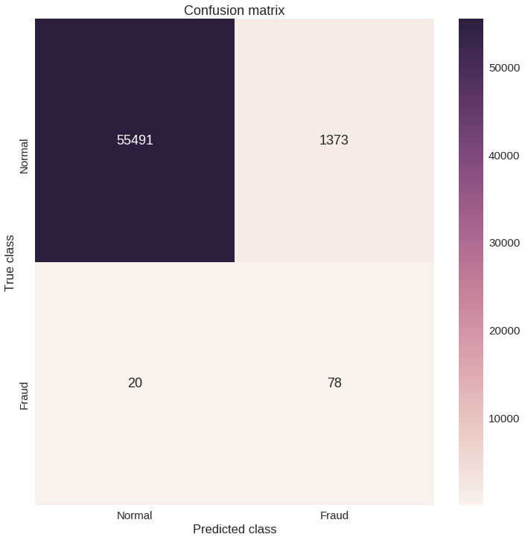
Confusion Matrix

Slide 17
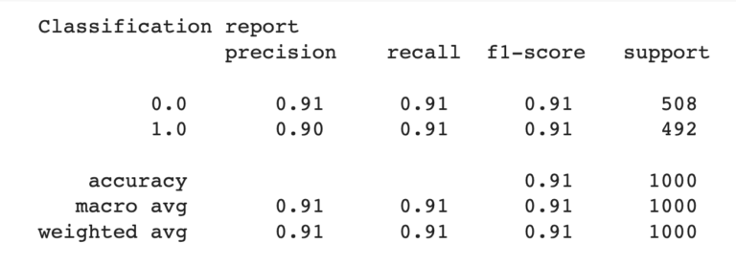
Model Accuracy

Slide 18
Model Discussion & Improvement
The accuracy rate is 91%. So, the credit card transactions fraud detection rate is high with this model.
Almost, all of the data are Normal transaction data. We can address more fraud data based dataset that the model trained and predict more accurately.
The network parameters could be optimized, including experimentation with different activation functions and regularization parameters, a higher number of hidden layers and units per hidden layer.

Slide 19

Any Questions???

